Slide 1

IBM University Engagement Project Submission
“Exploring the Power of Agentic AI with IBM Granite and LangFlow”

Slide 2
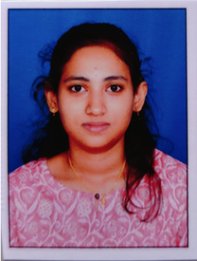
Project Tile – AgriSense AI: Autonomous Agronomic Decision & Agromet Advisory Platform
Domain of Project – Agriculture
Student Name | Recent Passport Photo | Email ID | Mobile number [WhatsApp]
M SWARNA LAKSHM |  | swarnalakshmim2006@gmail.com | 6360306436

Slide 3
Problem Statement
Problem Statement : AgriSense AI
The Challenge
Smallholder agriculture remains vulnerable to unpredictable micro-climatic shifts and sudden pathogen outbreaks. Fungal infections like Downy Mildew and Late Blight proliferate when relative humidity exceeds 78% RH, causing irreversible cellular damage days before visual symptoms appear. Farmers rely on ad-hoc dealer advice, causing severe agrochemical overdosing, while generic commercial LLMs invent hazardous, uncalibrated chemical recipes.
The Objective
Autonomous Agromet Sentinel: Continuously monitor live humidity and rainfall to trigger preemptive alerts before spore germination.
ICAR Package RAG Retrieval: Fetch verified active ingredients and exact dilution schedules (e.g., Metalaxyl @ 2g/L) from university research datasets.
Foliar Pathology Vision: Segment foliar lesions and chlorosis from uploaded field photos using deterministic OpenCV.
Multi-Agent Coordination: Orchestrate Sentinel, Vision, RAG, and Granite reasoning to generate complete 7-day treatment plans.
Vernacular Voice Delivery: Deliver full operational guidance in Kannada, Telugu, Hindi, and English with edge audio synthesis.

Slide 4
Proposed Solution
Proposed Solution: AgriSense AI
The proposed solution is an autonomous, multi-agent agronomic advisory platform built using Langflow, IBM watsonx.ai, and Granite Models to deliver proactive crop disease guidance and verified chemical calibration.
At its core, the solution uses a Retrieval-Augmented Generation (RAG) pipeline to fetch verified agronomic data from trusted ICAR (Indian Council of Agricultural Research) datasets. This data is embedded and stored in a vector database, enabling the system to retrieve exact active ingredients, safety intervals, and per-liter dilution formulas using Granite models.
The system consists of four key agents:
Agromet Sentinel Agent: Monitors real-time weather telemetry to predict pathogen outbreaks.
Foliar Vision Agent: Analyzes crop photos using OpenCV segmentation to quantify foliar lesions.
Agronomic RAG Agent: Retrieves validated ICAR chemical protocols, spray intervals, and safety guidelines.
Granite Orchestration Agent: Synthesizes weather risks, vision findings, and RAG knowledge into a 7-day roadmap.
The solution includes a user-friendly dashboard (built with Streamlit) that visualizes environmental risk gauges, foliar pathology masks, and 7-day treatment schedules with voice output. Langflow orchestrates agent workflows, while watsonx.ai ensures scalable model deployment and AI governance.

Slide 5
Technology Used
Langflow platform: For visually designing, orchestrating, and connecting multi-agent RAG pipelines and custom tools.
IBM Granite model (ibm/granite-4-h-small): For agronomic reasoning, JSON schema formulation, and generating personalized 7-day roadmaps.
IBM Cloud: Provides scalable, reliable cloud infrastructure and secure IAM token management to host and execute services.
RAG (Retrieval-Augmented Generation): Fetches real-world ICAR/KVK agronomic protocols first, eliminating hallucinations and ensuring safe active ingredients.
IBM watsonx.ai: For enterprise model deployment, prompt engineering, AI governance, and low-latency inference.
Vector Database (ChromaDB): For vectorizing and retrieving chunked ICAR agronomic research publications.

Slide 6
Langflow component Used
Chat Input: Interface where farmers submit crop type, field location, and upload foliar leaf/fruit images (text/image).
IBM watsonx AI Agent: Ingests telemetry, vision metrics, and farmer queries to orchestrate Granite reasoning.
Name of IBM Granite model: ibm/granite-4-h-small (Granite 4.0) — Fast, efficient, and precise for real-time structured agronomic JSON generation.
Chat output: Displays AI-generated 4-tab advisory (Risk Sentinel, Pathology Mask, 7-Day Treatment Plan, Economic ROI).
Custom Component / Vector Store (ChromaDB): Stores and semantically retrieves ICAR chemical packages and dilution ratios.
Custom OpenCV Vision Component: Preprocesses and segments uploaded crop photography into necrotic lesion masks.

Slide 7
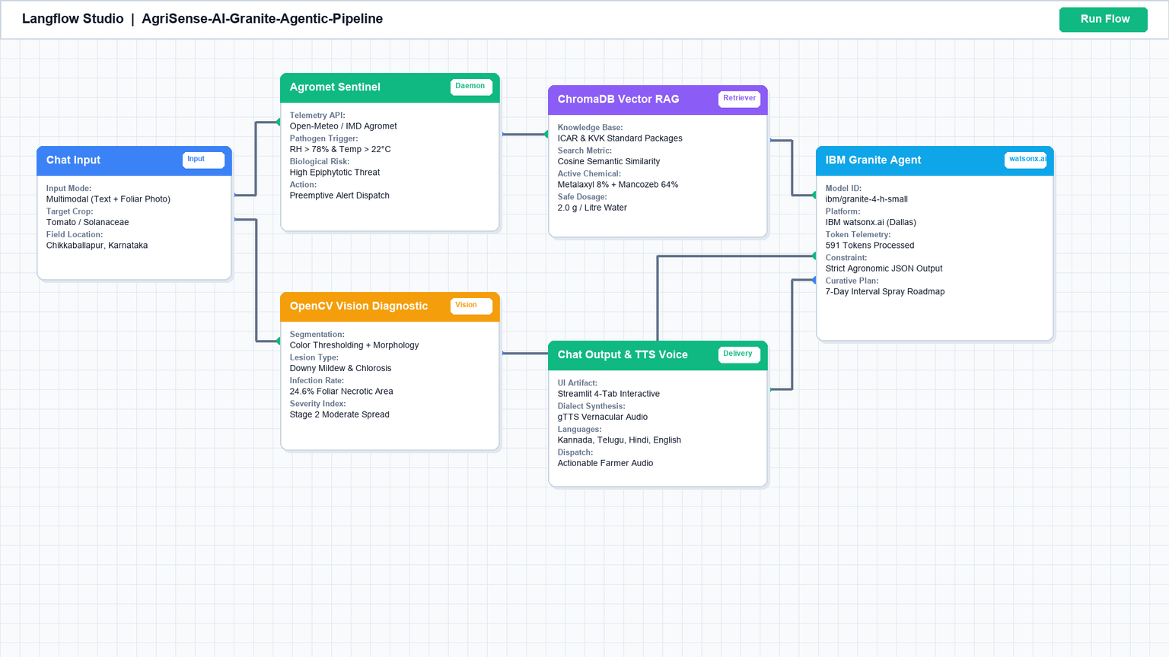
Langflow workflow

Slide 8
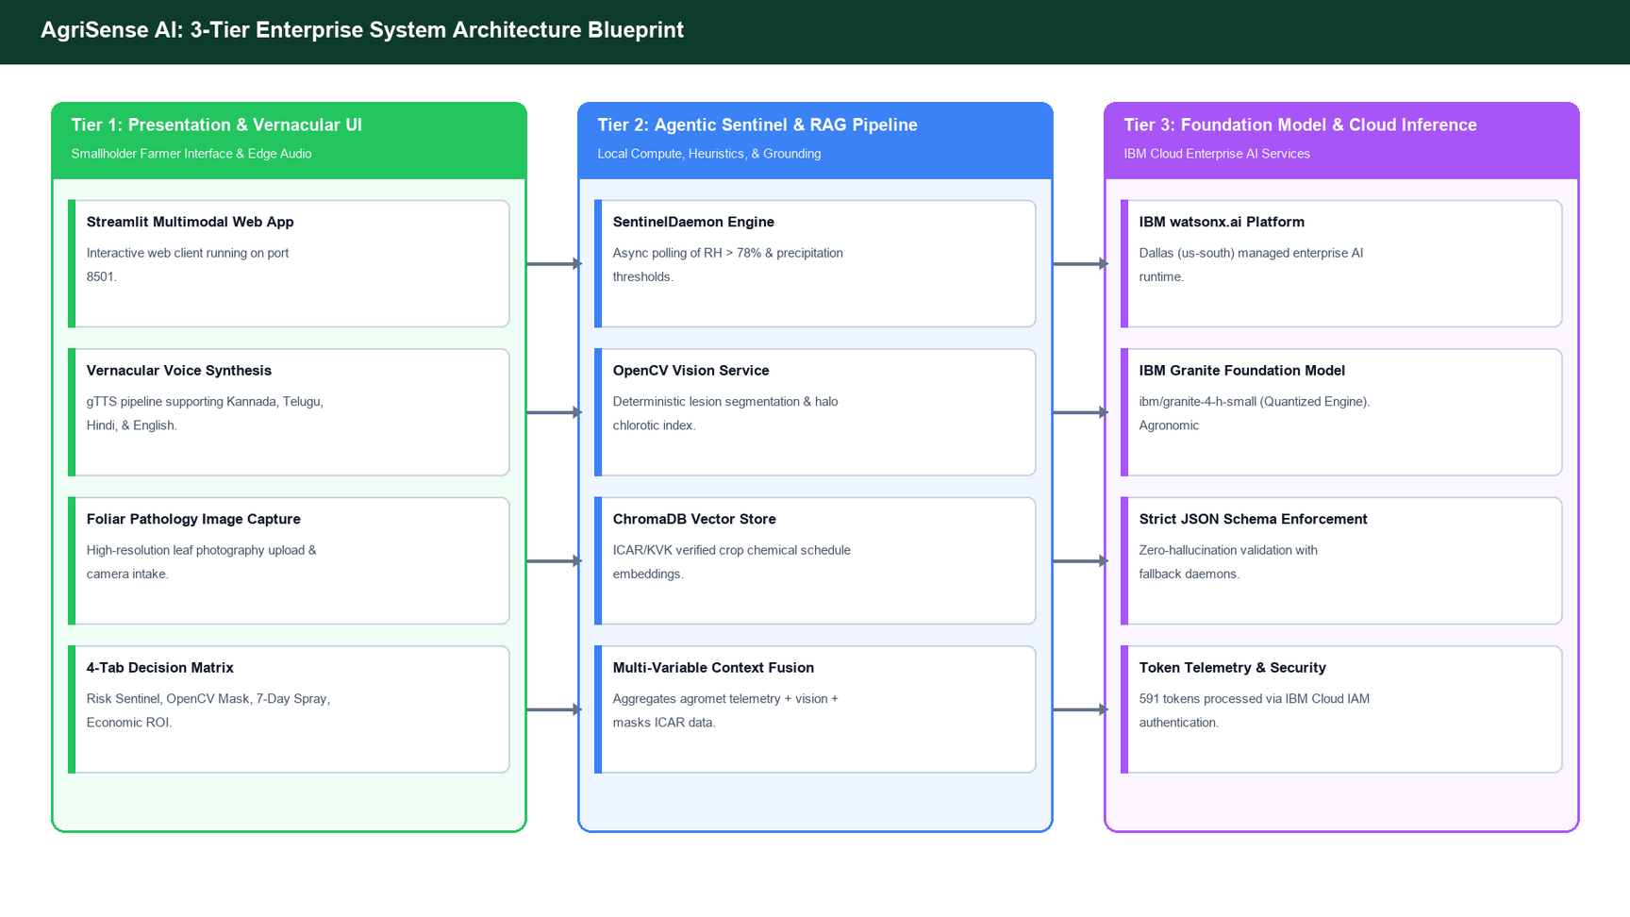
Architecture blueprint

Slide 9

Role of Agentic AI in the solution
Agentic AI enables AgriSense AI to function as an intelligent, autonomous agronomic sentinel rather than a simple chatbot. Using IBM watsonx.ai and IBM Granite models, it coordinates multiple specialized agents to deliver proactive crop health guidance.
Each agent performs a specific role—such as monitoring agromet danger thresholds, segmenting foliar lesions, retrieving ICAR treatment protocols, and simulating economic crop loss trade-offs—while working collaboratively. This multi-agent approach ensures efficient task execution and accurate results.
Agentic AI also brings environmental context awareness, evaluating real-time humidity, temperature, and rainfall probability to detect epiphytotic danger windows. It supports proactive real-time adaptation, automatically firing preemptive warnings days before visual symptoms appear.
Overall, Agentic AI transforms precision agriculture from passive query-response into an autonomous, goal-driven digital agronomist that preserves smallholder yield and optimizes farm profitability.

Slide 10
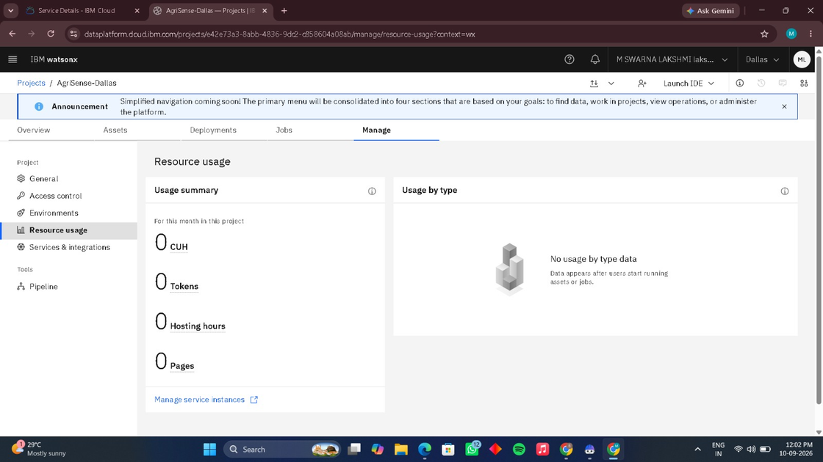
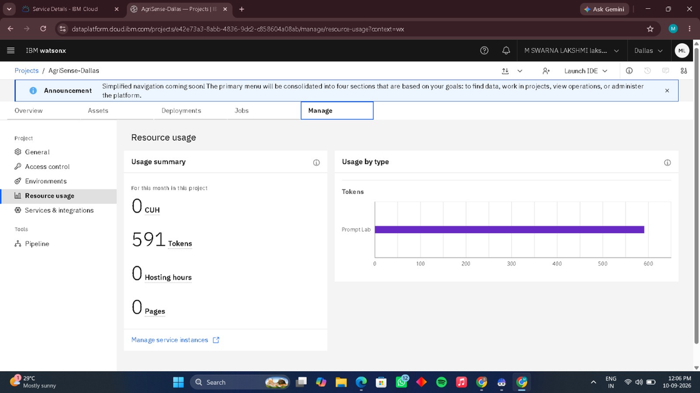
Token Usage
591 Tokens Processed (ibm/granite-4-h-small)
Before Prompt
After the Prompt
·
·
·

Slide 11
Novelty and Uniqueness
The proposed AgriSense AI stands out by combining Agentic AI, RAG, and precision agrometeorology into a single intelligent system: .
Multi-Agent Intelligence: Multiple specialized agents (Sentinel, Vision, RAG, Granite) collaborate to deliver accurate, context-aware agronomic guidance.
RAG-Based Accuracy: Integrates real-time retrieval from ICAR datasets, eliminating LLM hallucinations and guaranteeing safe active ingredients
.
Preemptive Agromet Early Warning: Autonomously computes fungal epiphytotic risk scores based on live micro-climate conditions (>78% RH threshold).
Multi-Modal Input & Vision: Supports text, localized voice, and OpenCV lesion-segmented crop photography for diagnostic precision.
Real-Time Feedback & Adaptation: Continuously recalculates treatment schedules and spray timing based on shifting weather forecasts.
Economic Decision Simulator: Goes beyond diagnosis to quantify financial ROI, comparing chemical input costs against projected crop loss.
Scalable & Enterprise-Ready: Built on IBM watsonx.ai with IBM Granite models, ensuring enterprise reliability, low latency, and robust governance.

Slide 12
Git Hub Link
Working GitHub Repository URL:
[https://github.com/swarna-builds/AgriSense-AI-IBM-Granite]
(https://github.com/swarna-builds/AgriSense-AI-IBM-Granite)
app.json — Agentic workflow schema and service dependency manifest
yourproblemstatement.pdf — Formal problem formulation and ICAR objectives
your projectpresntation.pptx — Final 15-slide technical presentation deck
Source Code Repository — core/, services/, app.py, and automated test suite
·

Slide 13
Future Scope
1.Integration with IoT Soil Probes & Multispectral Drone Telemetry:
TThe system can be integrated with LoRaWAN soil moisture, temperature, and N-P-K field probes as well as multispectral drone cameras. This will enable AgriSense AI to collect real-time sub-surface and aerial crop vigor data, providing hyper-localized variable-rate spraying and automated precision drip irrigation recommendations.
2.Edge AI Deployment & Offline Vernacular Voice Assistant:
Optimizing and quantizing IBM Granite models for deployment onto low-cost edge micro-servers in village agricultural centers. This will provide instantaneous foliar disease diagnosis and natural spoken-dialect advisories even in remote farming communities without cellular internet connectivity
·
·
·

Slide 14
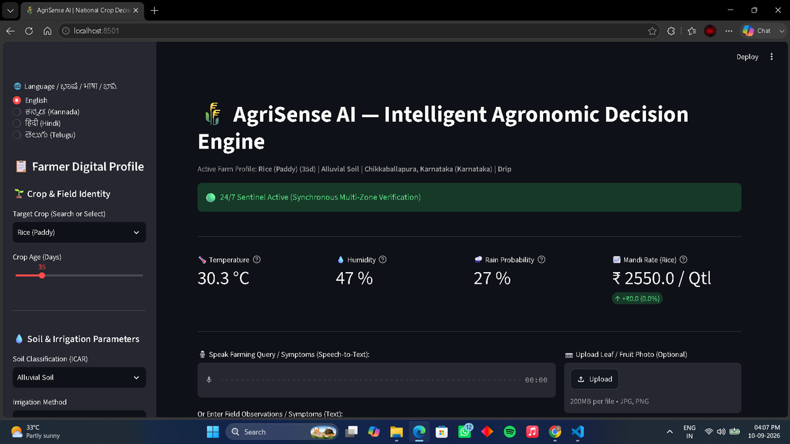
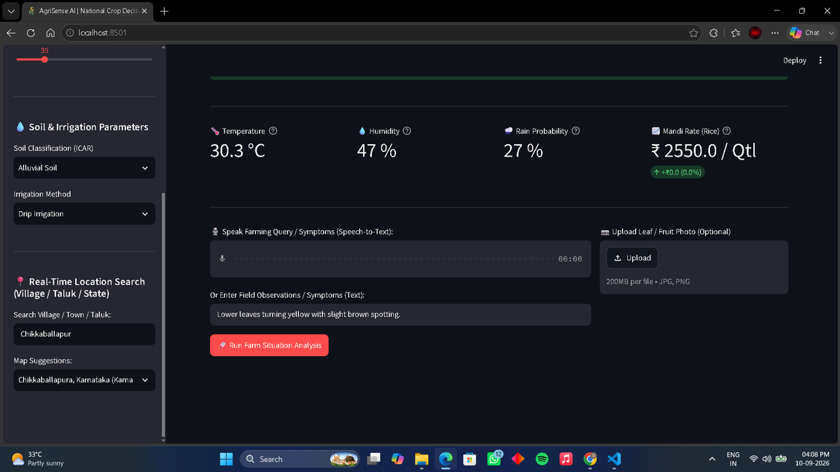
APP UI/UX INTERFACE

Slide 15
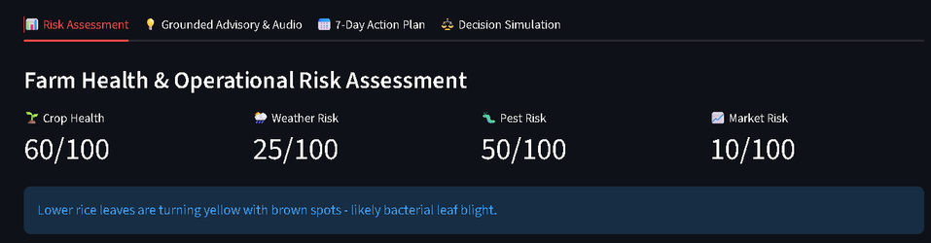

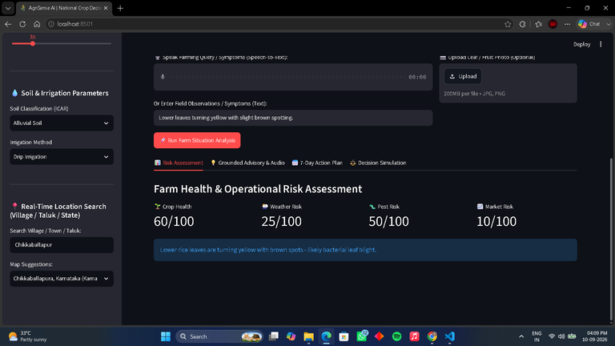
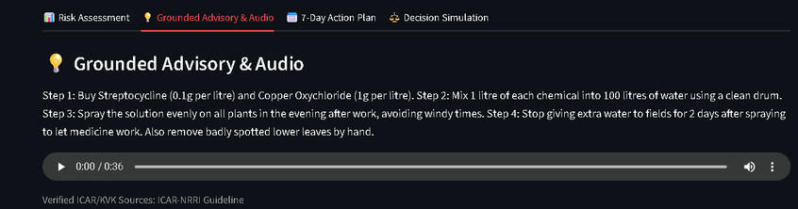
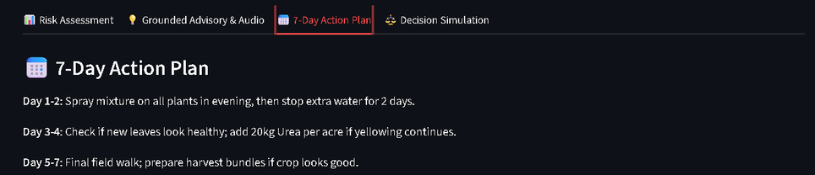
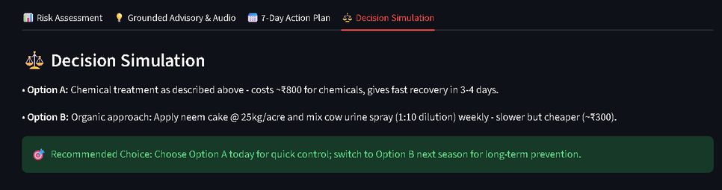
APP ANALYSIS

Slide 16
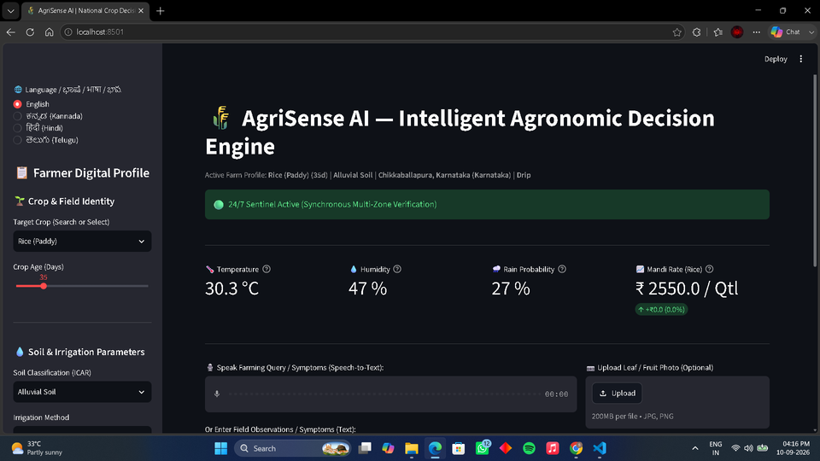
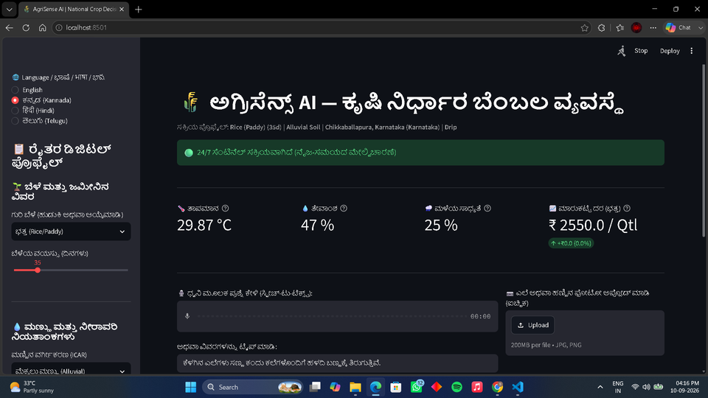
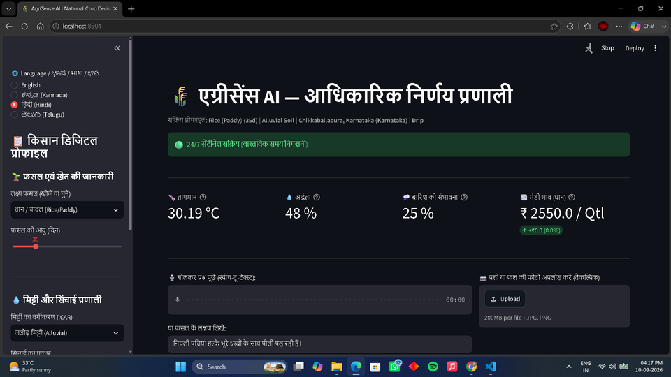
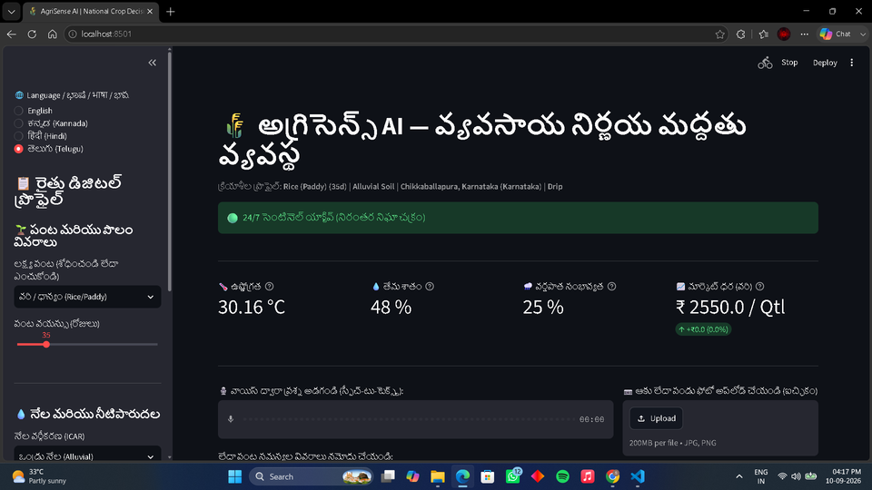
MULTILINGUAL SUPPORT WITH VOICE INTEGRATION

Slide 17
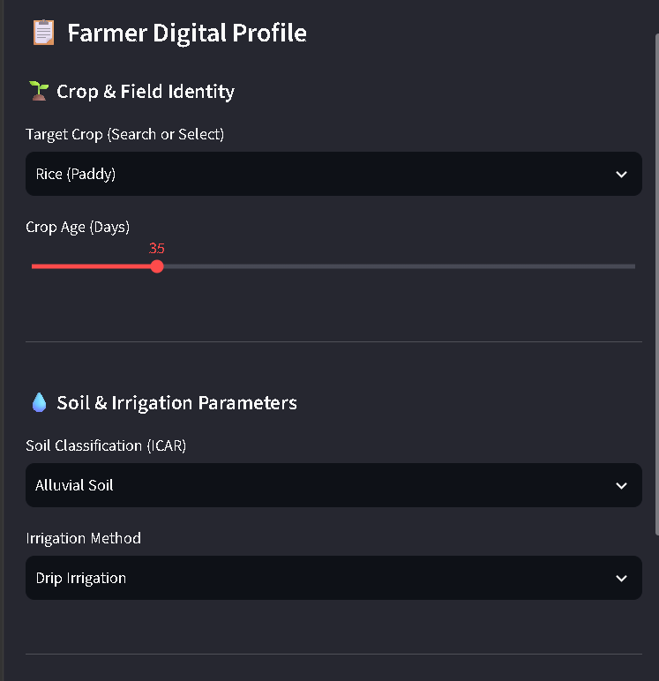
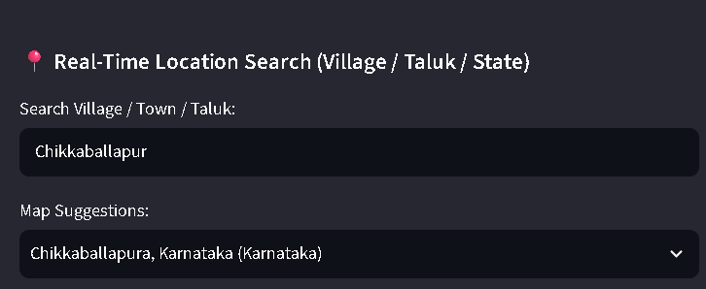
GeoFarm Analytics: Smart Profiles & Location Insights

Slide 18
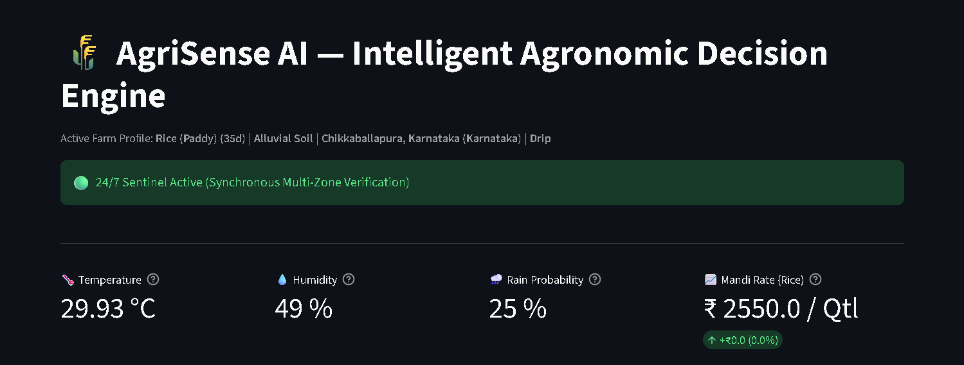
AgriAlert: 24/7 Risk & Mandi Price Predictor

Slide 19
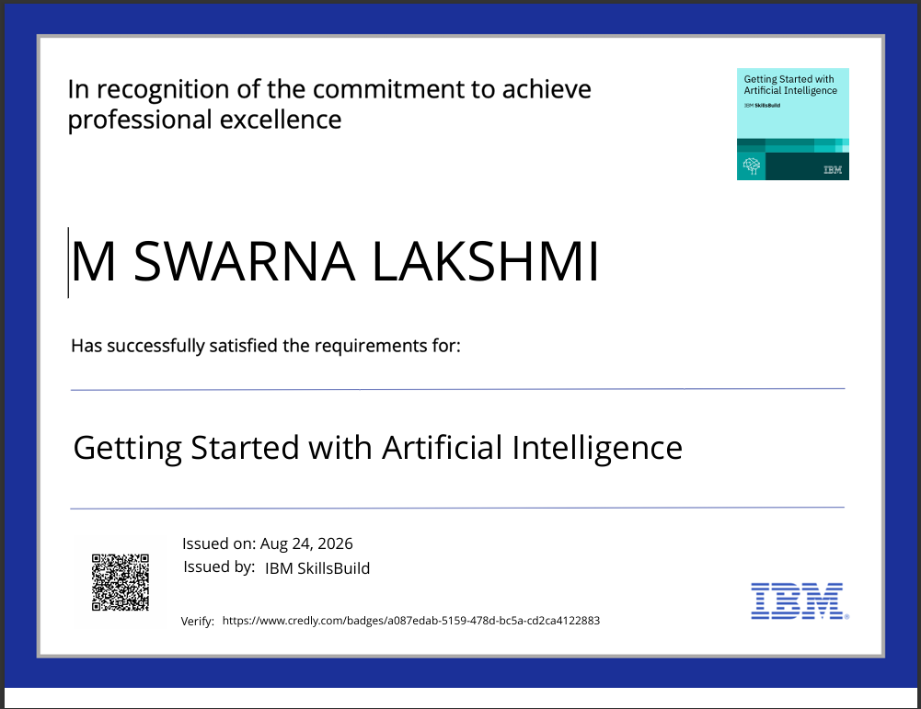
Certificates Earned:

Slide 20
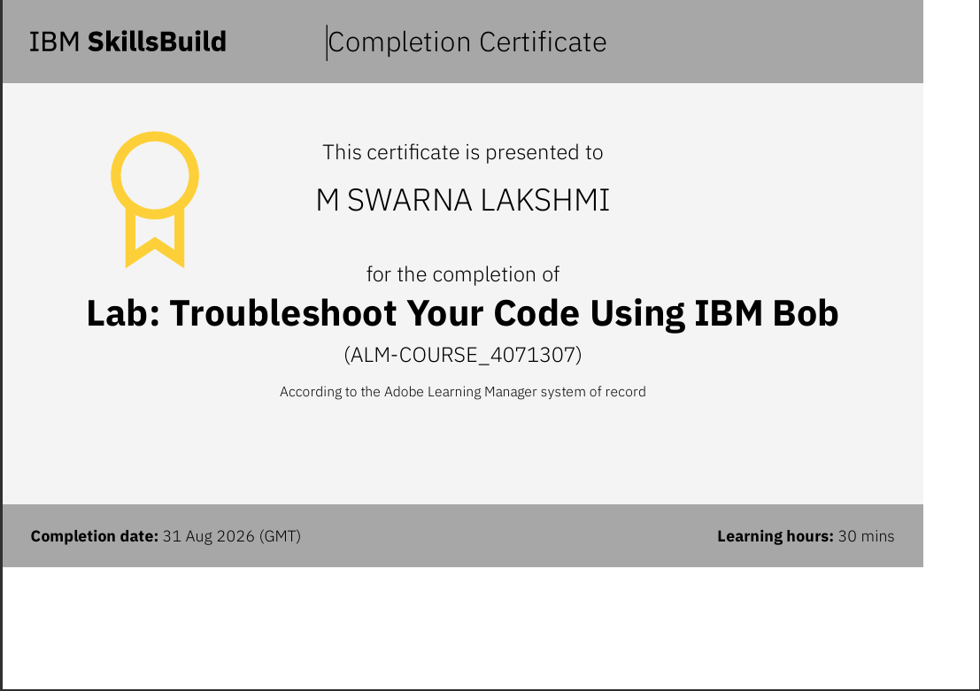
Certificates Earned:​

Slide 21


